Slide 1



PROJECT EVALUATION
As an Intern Data Analyst
BE THE CHANGE

Slide 2


Hi There....
02
I am Pandula
WELCOME
This is a Summery of My joureny as a Data Analyst in Prestigous Company Vizamatrix in First three months

Slide 3


WHAT IS SPECIAL IN
VIZUAMATRIX
Working in Vizuamatix as an Intern provided me new scop of experiances and new technological stack was learnt .
Also work under experianced supervisors is another achievement for me.

Slide 4
04
FOCUSED AREAS
Specially in my first three months in internship Period engaged on several aspects in Data Science.
01
Natural Language Processing Tools
02
Machine Learning & Deep Learning Concepts
03
Flask Project Development & R Studio based Projects

Slide 5




05
WHAT I DID
With the Aid of the Supervisors and my Fellow team I specially put focus on These Work :-
Learn New Concepts in Data Science
Parallizing Processes to Gain Efficency
New Statistic Concepts

Slide 6
06
WHAT I HAVE DONE
Specially Engage in Several Major Projects is really aided me to Move Forward
ECL Model -
Basically Models investigated and created Notebooks for the worked Models
NLP Project
Majorly worked on Frontend & Flask Backend development
NLP
ECL
Flask Demo Project
Implemented Several ML based Projects
Kubeflow
Using virtualization tools like Docker , ML flows Created.
Flask
K

Slide 7
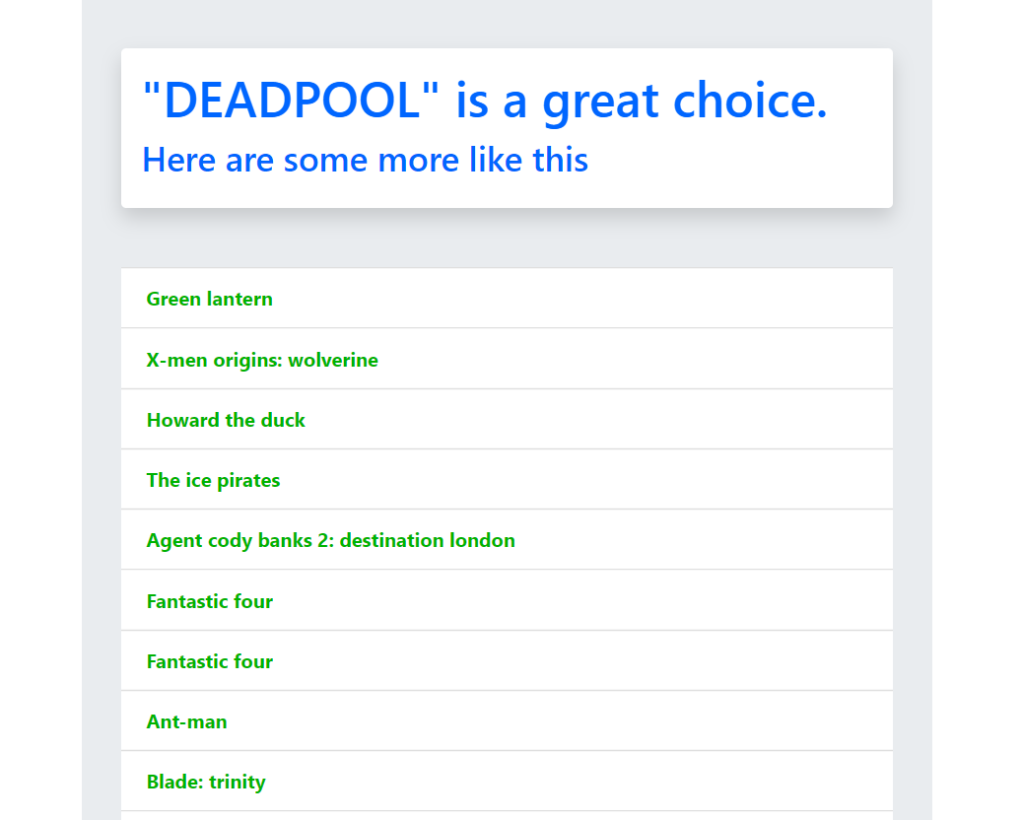
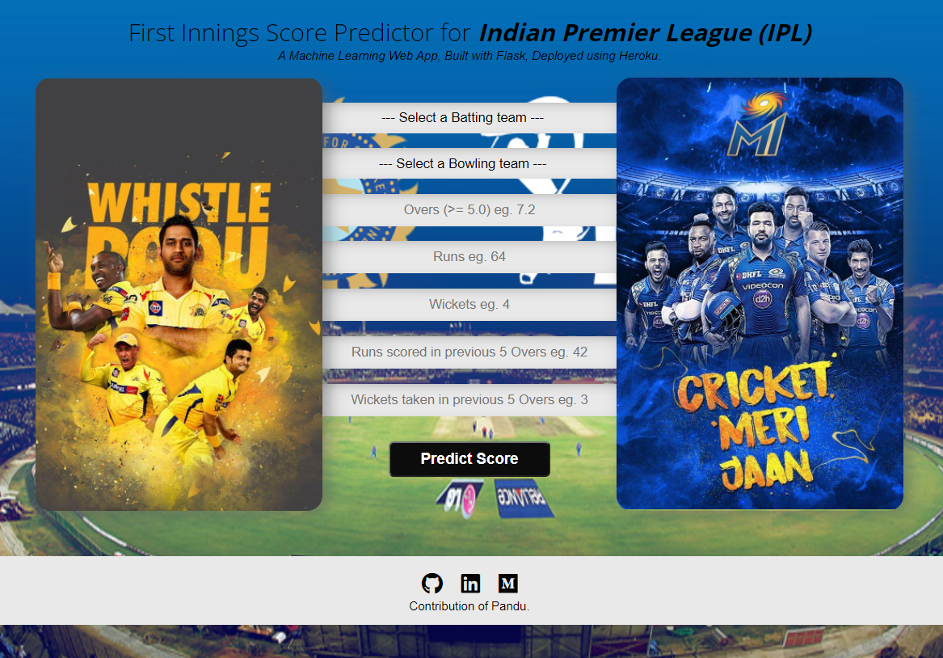


MY PROJECTS
07
Here are some of my Demo Projects
Movie Recommendation System
Flask projects are immensly compatiable for Machine Learning Projects
Score Predict System

Slide 8




08
VISION
Enhance knowledge in Data Science and Data Engineering
Move into the Pinnacle of the Stream of Data Science

Slide 9




09
MISSION
Working dedicated and perseverance for broader my knowledge in machine Learning , Artificial Intelligence
NLP stands for Neuro-Linguistic Programming. Linguistic refers to language; programming refers to how that neural language functions. In other words, learning NLP is like learning the language
Working on New Concepts on Natural Languuage Processing

Slide 10



10
SERVICES
Analyzation of NLP
Jupyter Notebook Services
ECL Models

Slide 11


11
ANALYTICS AREA
Based on VX Analytics of Our Company , I have worked on Several Tools
Jupyter Notebook & Google Colab
Docker and Kubeflow

Slide 12




12
FUTURE PROGRESS
Improve Skills in Deep Learning and Neural Networks
On my Internship period i am hoping to polish my knowledge and skills in Data Science
Computer Vision based Solutions
Natural Language Processing based enhancements

Slide 13

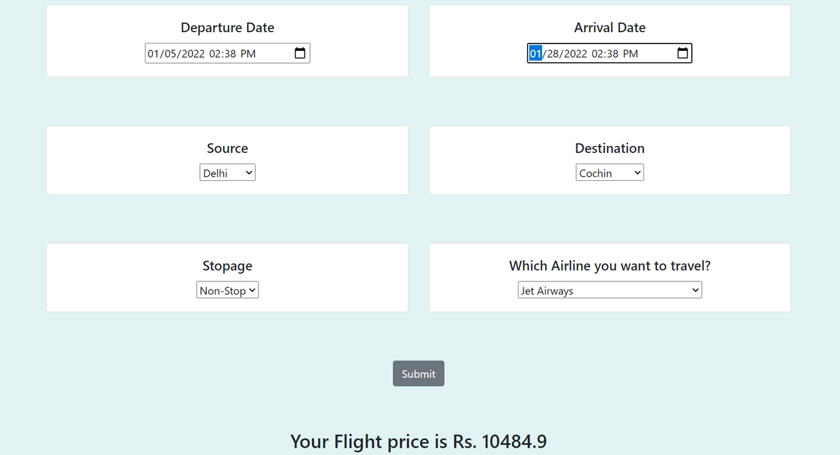
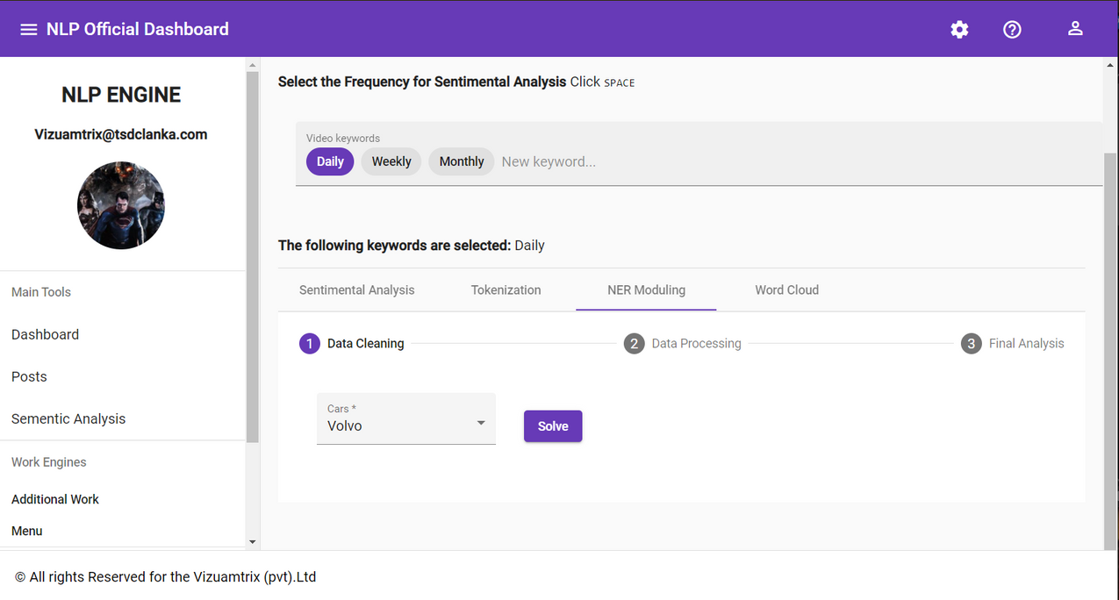

14
MY PORTOFOLIO
Here is Some of My Work that Have done
FLIGHT PREDICTION SYSTEM
NLP ANGULAR DASHBOARD

Slide 14

16
SELF EVALUATION
85%
90%
95%
Working with New Concepts and Technologies
Working in Virtual Environment with Office Atmosphere
Engage with the Collegues and Supervisors

Slide 15


18
WORK TOGETHER
Working with a Team , Provided me so many benefits in different circumstances and encourage me to follow my work with motivation

Slide 16




OUR TEAM
19
My Fellow Team Members and Supervisors to continue my journey in Success
MR. SUJITH
ANUSHANGA
Main Supervisor in Our Team and Coordinator
Guide me in NLP Module Project
MRS. GAYATHRI
THILINA
Supervisor and Guided us in Several Projects
Work with me in Outlier Prediction and Sentimental Analysis

Slide 17


BE STRONG AND FOLLOW YOUR PASSION

